Slide 1


January 2019
Campaign contribution limits and corruption
Evidence from the 50 states
Mark Clayton Hand
PhD Student, The University of Texas at Austin • @markchand • mark.hand@utexas.edu
Notes:
Mark, see this http://www.stat.columbia.edu/~gelman/presentations/cuips_presentation.pdf

Slide 2
Are State Level Campaign Contribution Limits Correlated with Corruption?
See twitter.com/markchand for:
This presentation
This paper
Code and (most of the) data

Slide 3
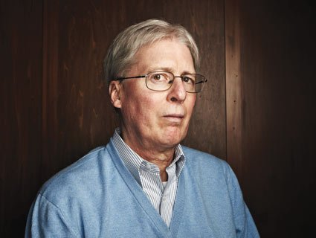

Slide 4
Prior Work
On state level campaign finance
Barber 2016, Hamm and Hogan 2008; Primo and Milyo 2006
On state level corruption
Walker and Calcagno 2011, Glaeser and Saks 2006, Crider and Milyo 2013, Liu & Mikesell 2014, Dincer 2018, Alt and Lassen 2012
Boylan and Long 2003, Cordis and Milyo 2016, Dincer and Johnston 2017
On state level campaign finance and corruption
Cordis and Milyo 2013

Slide 5
Question
Are campaign contribution limits at the state level correlated with lower levels of political corruption?

Slide 6
Data
DVs: Corruption
Corruption Convictions Index / Corruption Reflections Index
Source: Institute for Corruption Studies
IVs: State Level Contribution Limits
Individual-to-campaign / PAC-to-campaign / Individual-to-party
Source: Michael Barber
Controls
Source: James Alt

Slide 7
Design(s)
Panel
Two-way fixed effects with controls
Dummy variables for each type of limit
1990-2004
First Differences
Increase, decrease, imposition and removal
1990-2012

Slide 8
Results
1990-2004 panel model
No correlation with convictions index
One correlation with reflections index?
1990-2012 first differences model
No correlation with convictions index
No correlation with reflections index

Slide 9
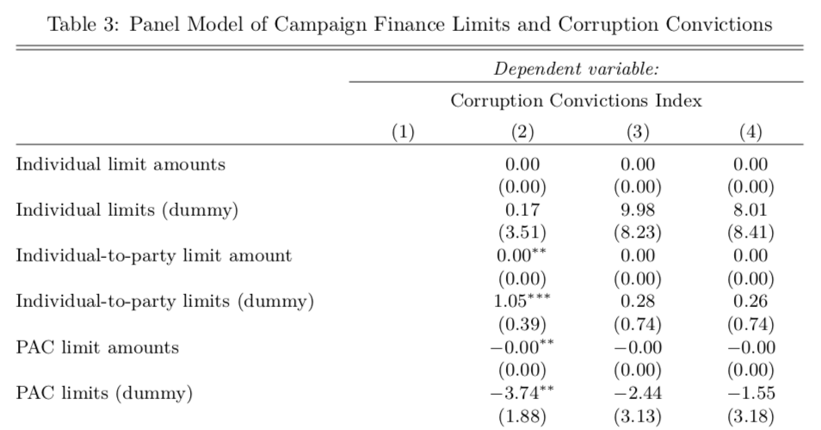
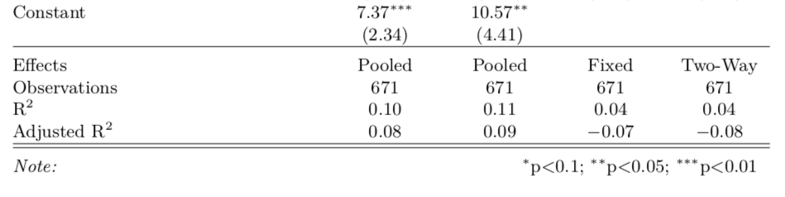
[Controls omitted]

Slide 10
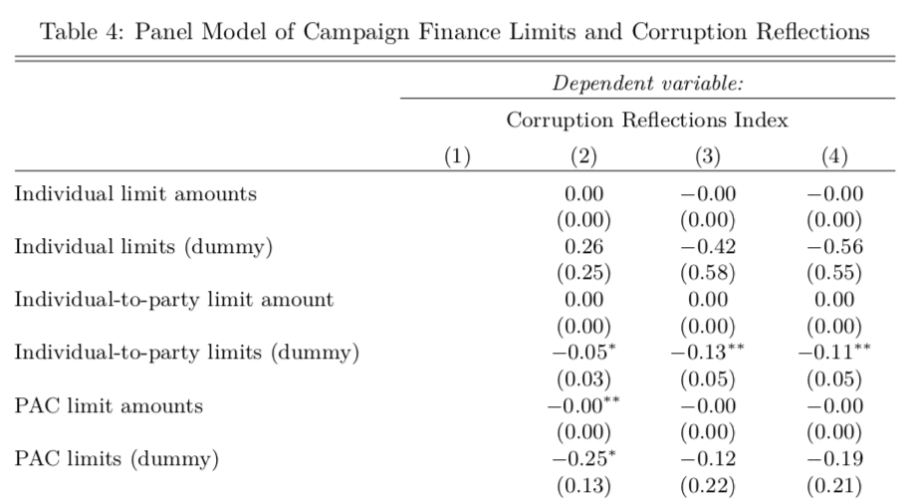
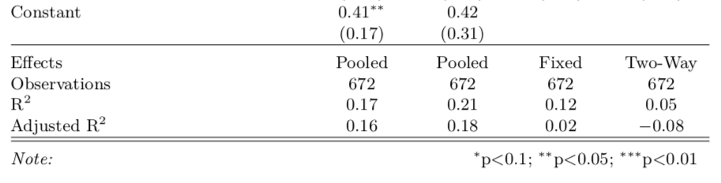
[Controls omitted]

Slide 11
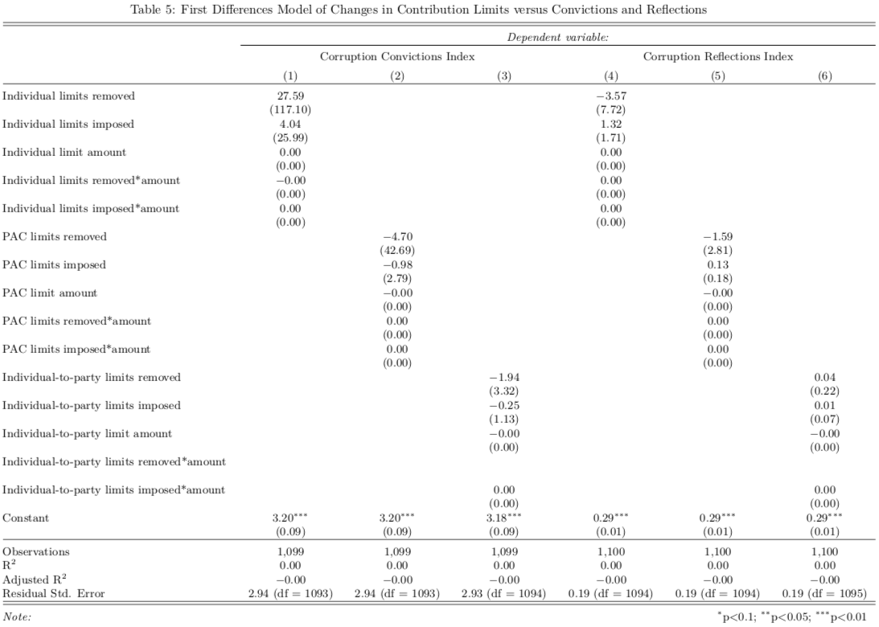

Slide 12
Discussion
Alternative explanations
Limitations
Further permutations

Slide 14
January 2019
Thanks!
Campaign Contribution Limits and Corruption: Evidence from the 50 states
Mark Clayton Hand
PhD Student, The University of Texas at Austin • @markchand • mark.hand@utexas.edu

